Slide 1

Home-Based Healthcare Professionals and Caregivers
A Comprehensive Overview of Their Role and Impact
LECTURE BY
BANK-KADEJO ADEDAMOLA
MD(AM) ND, DO FWAP CNIM
DECEMBER, 2024
09041210799, 07059872818

Slide 2
CONTENTS
INTRODUCTION
BRIEF HISTORY
WHAT IS HOME BASED HEALTHCARE
WHAT DO THEY DO?
BENEFIT/IMPACT
CONTRADICTIONS & CHALLENGES
CONCLUSION

Slide 3
Introduction
Definition:
The Association of Home-Based Healthcare Professionals and Caregivers provide medical, therapeutic, or supportive services to individuals in their homes. It is a established under the CAC Act of the federal Republic of Nigeria with the mandate to advance the cause of public health by providing training and education to home based healthcare professionals and caregivers

Slide 4
AIMS AND OBJECTIVES OF THE ASSOCIATION
AIMS AND OBJECTIVES OF THE ASSOCIATION
To promote the well being of individual by fostering collaboration among health care providers, patient and families.
To reduce healthcare disparities by increasing access to home base health care services in underserved communities through advocacy and resourse mobilization
To contribute to healthcare policy development by advocating for policies that support home based care and improve the overall health and well being of the population
The promote the interest and welfare of our members

Slide 5

HEALTHCARE PROFESSIONALS AND CAREGIVERS

Slide 6
HEALTHCARE PROFESSIONALS AND CAREGIVERS
Physicians
Paramedics
Registered Nurses RNs
Complementary Healthcare Practitioners
Social Worker
Dietitian
Physical Fitness Expert
Psychologist
Licensed Practical Nurses (LPNs)/Licensed Vocational Nurses (LVNs
Physical Therapists
Occupational Therapists
Speech Therapists
Home Health Aides (HHAs
Rehabilitation Therapist
Personal Care Aides (PCAs)

Slide 7
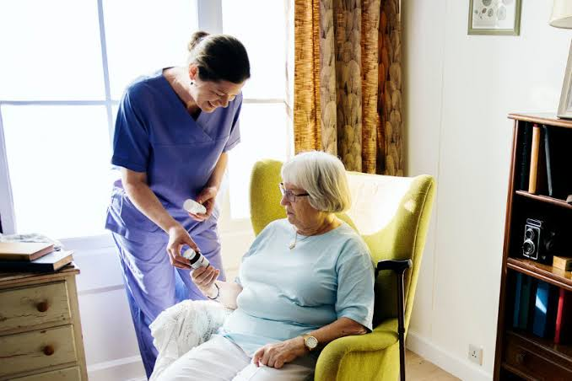
Introduction

Slide 8
History
Origins:
Home health care, as a concept, has evolved significantly over time. Its roots can be traced back to ancient civilizations, where families and communities took care of their sick and elderly within the confines of their homes.
Began with informal caregiving by family and community members.
Evolved with professional nursing services in the late 19th century.
Milestones:
Introduction of home health agencies in the 20th century.
Expansion through Medicare/Medicaid programs.

Slide 9
History
Early Pioneers:
Florence Nightingale: Known as the founder of modern nursing, Florence Nightingale’s contributions to home healthcare cannot be overstated.
Clara Barton: Barton, the founder of the American Red cross, also made significant contributions to home health care. She provided aid and medical assistance to soldiers during the civil war.
Lillian Wald: A nurse and social worker, is credited with establishing the first organized Home Health Service in the United States
Mary Breckinridge: A nurse-midwife, founded the Frontier Nurising Service in rural Kentucky.
Jeanne Jugan: A French nun, founded the Little Sisters of the Poor, International organization that provides care for the elderly poor.

Slide 10
What is Home-Based Healthcare?
Definition:
A healthcare approach that delivers medical, therapeutic, and supportive services directly to patients in their homes.
Key Components:
Personalized care.
Multidisciplinary team involvement.
Focus on patient comfort and holistic well-being.

Slide 11
What Do They Do?
1. Medical Care:
Administer medications, wound care, and monitor health conditions.
2. Therapeutic Support:
Implement recovery plans and assist with therapies (physical, occupational, speech).
3. Personal Care:
Support with hygiene, mobility, and daily living activities.
4. Household Assistance:
Prepare meals, manage errands, and handle light housekeeping.
5. Emotional Support:
Reduce loneliness and provide companionship.

Slide 12
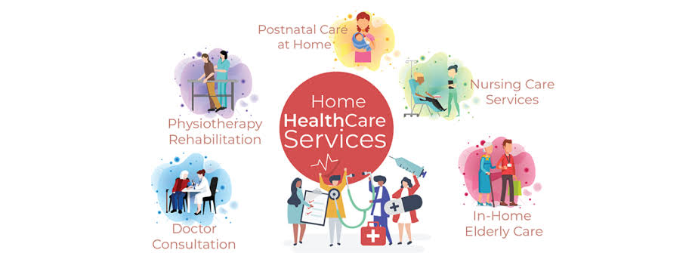
What Do They Do?

Slide 13
Benefits of Home-Based Care
Personalized Attention: Tailored to individual needs.
Comfort: Patients remain in familiar environments.
Cost-Efficiency: Reduces hospital admissions and associated expenses.
Family Involvement: Encourages active participation in care.
Improved Outcomes: Supports recovery and enhances quality of life.

Slide 14
Contradictions and Challenges
Contradictions:
Not suitable for patients requiring intensive medical care.
Limited access to advanced equipment.
Challenges:
Ensuring safety in non-clinical environments.
Managing emotional and physical strain for caregivers.
Balancing professional and personal boundaries.

Slide 15
Conclusion
Home-based healthcare is a vital component of modern healthcare systems.
It addresses the needs of diverse patient groups while promoting independence and dignity.
Challenges exist, but its benefits and impact on improving healthcare access and outcomes are undeniable.
Future advancements in technology and training will further enhance the effectiveness of home-based care.

Slide 16
Questions & Answers
Feel free to ask questions or share your thoughts.

